Slide 1




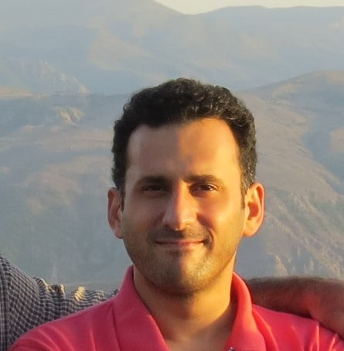
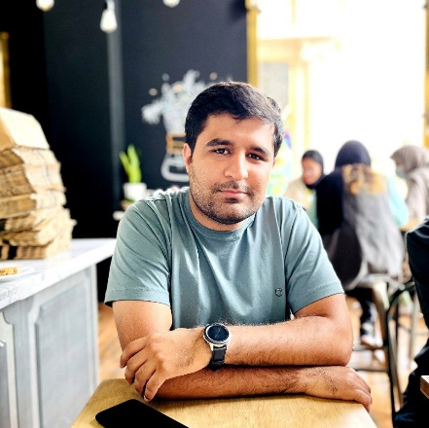
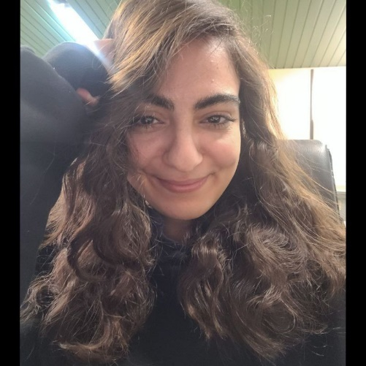



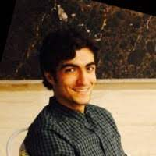
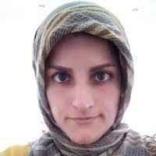
We Select Cells!
Our TA’s
Reza Amir Ali Mehdi Mehran Mina Mostafa Sina Saba
Yara Mina

Slide 2
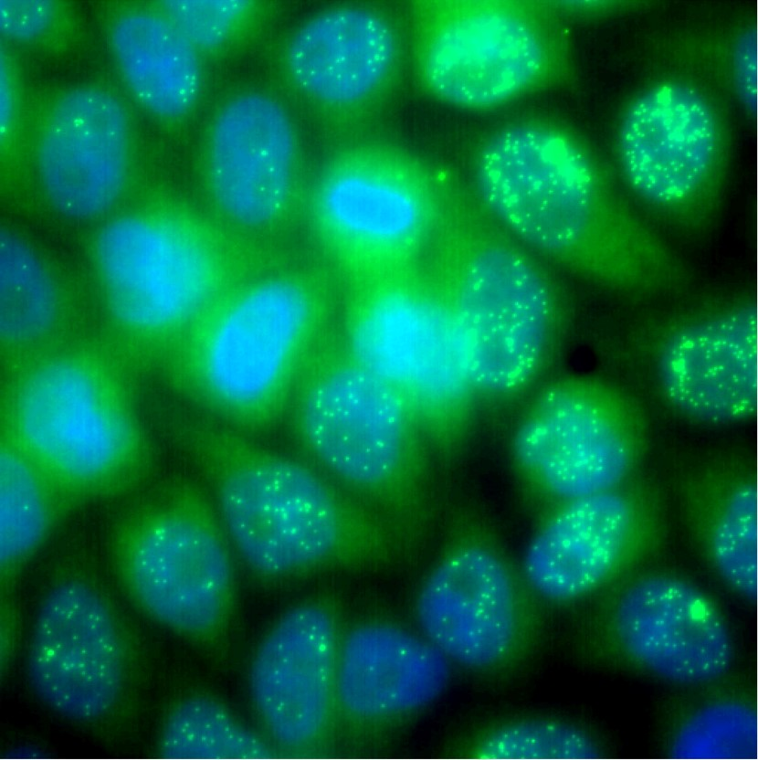
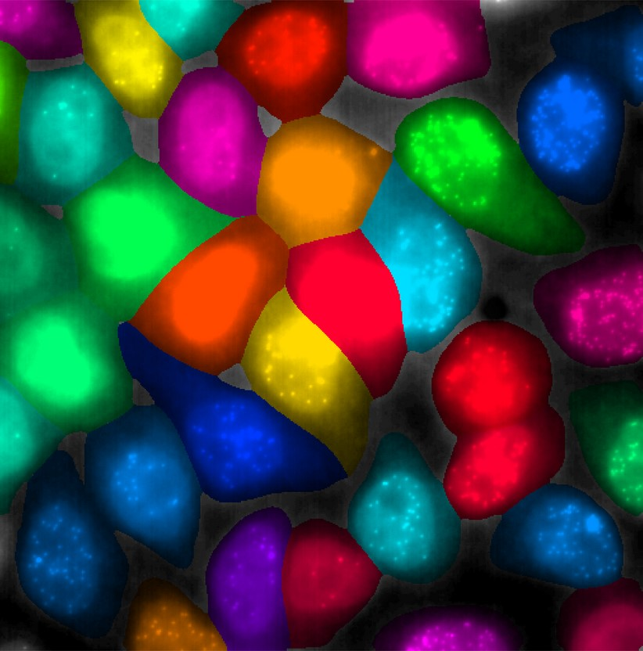

Save lives with
Cellular Segmentation

Slide 3
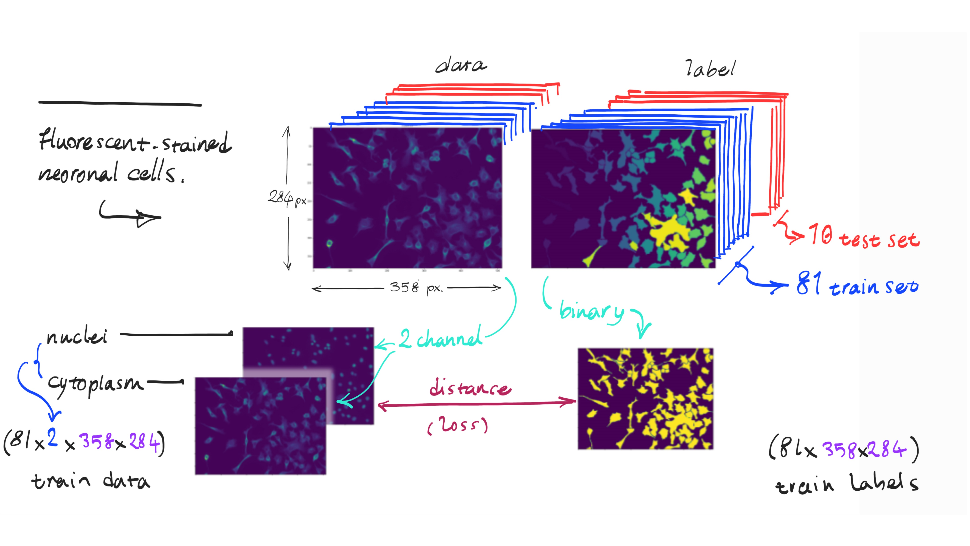
Dataset

Slide 4
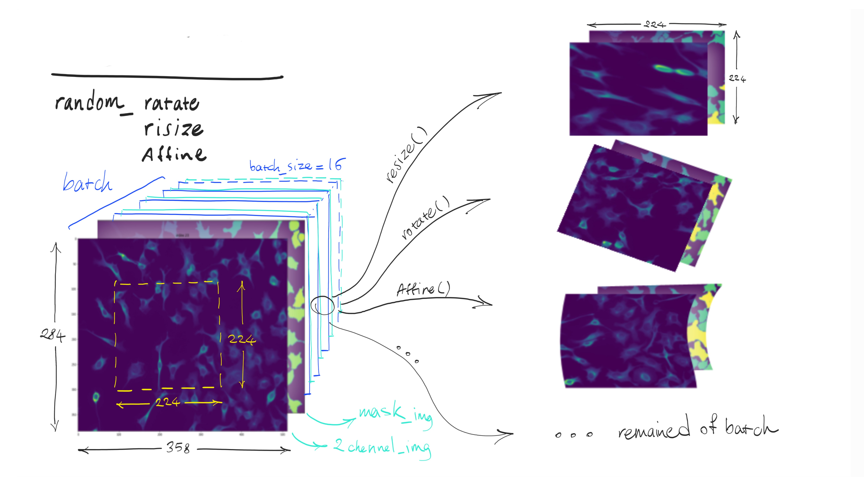
Augmentation

Slide 5
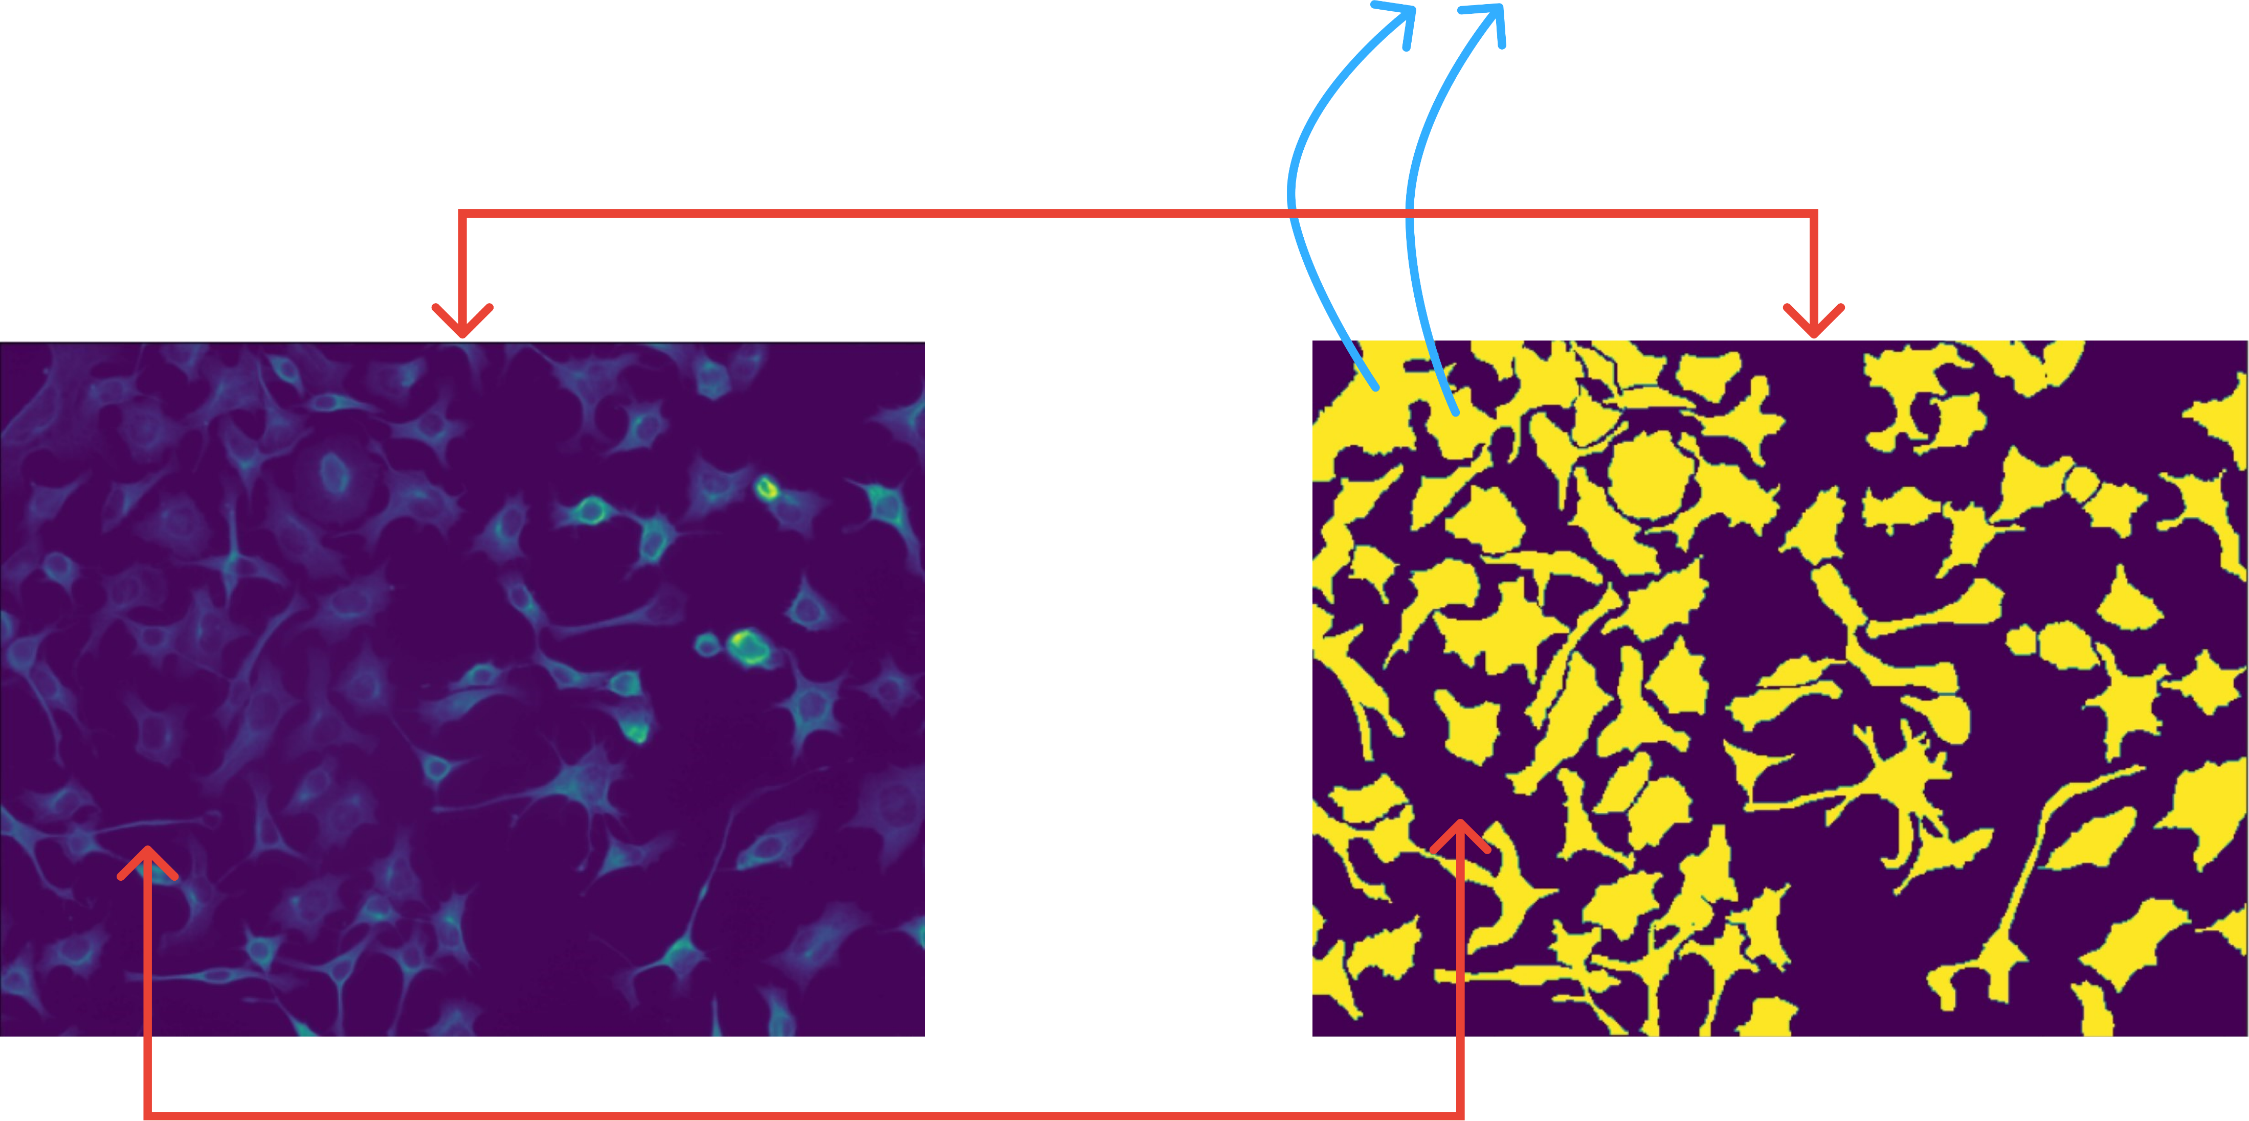
Dataset Problems
over-merging
Labeling error
Labeling errors

Slide 6
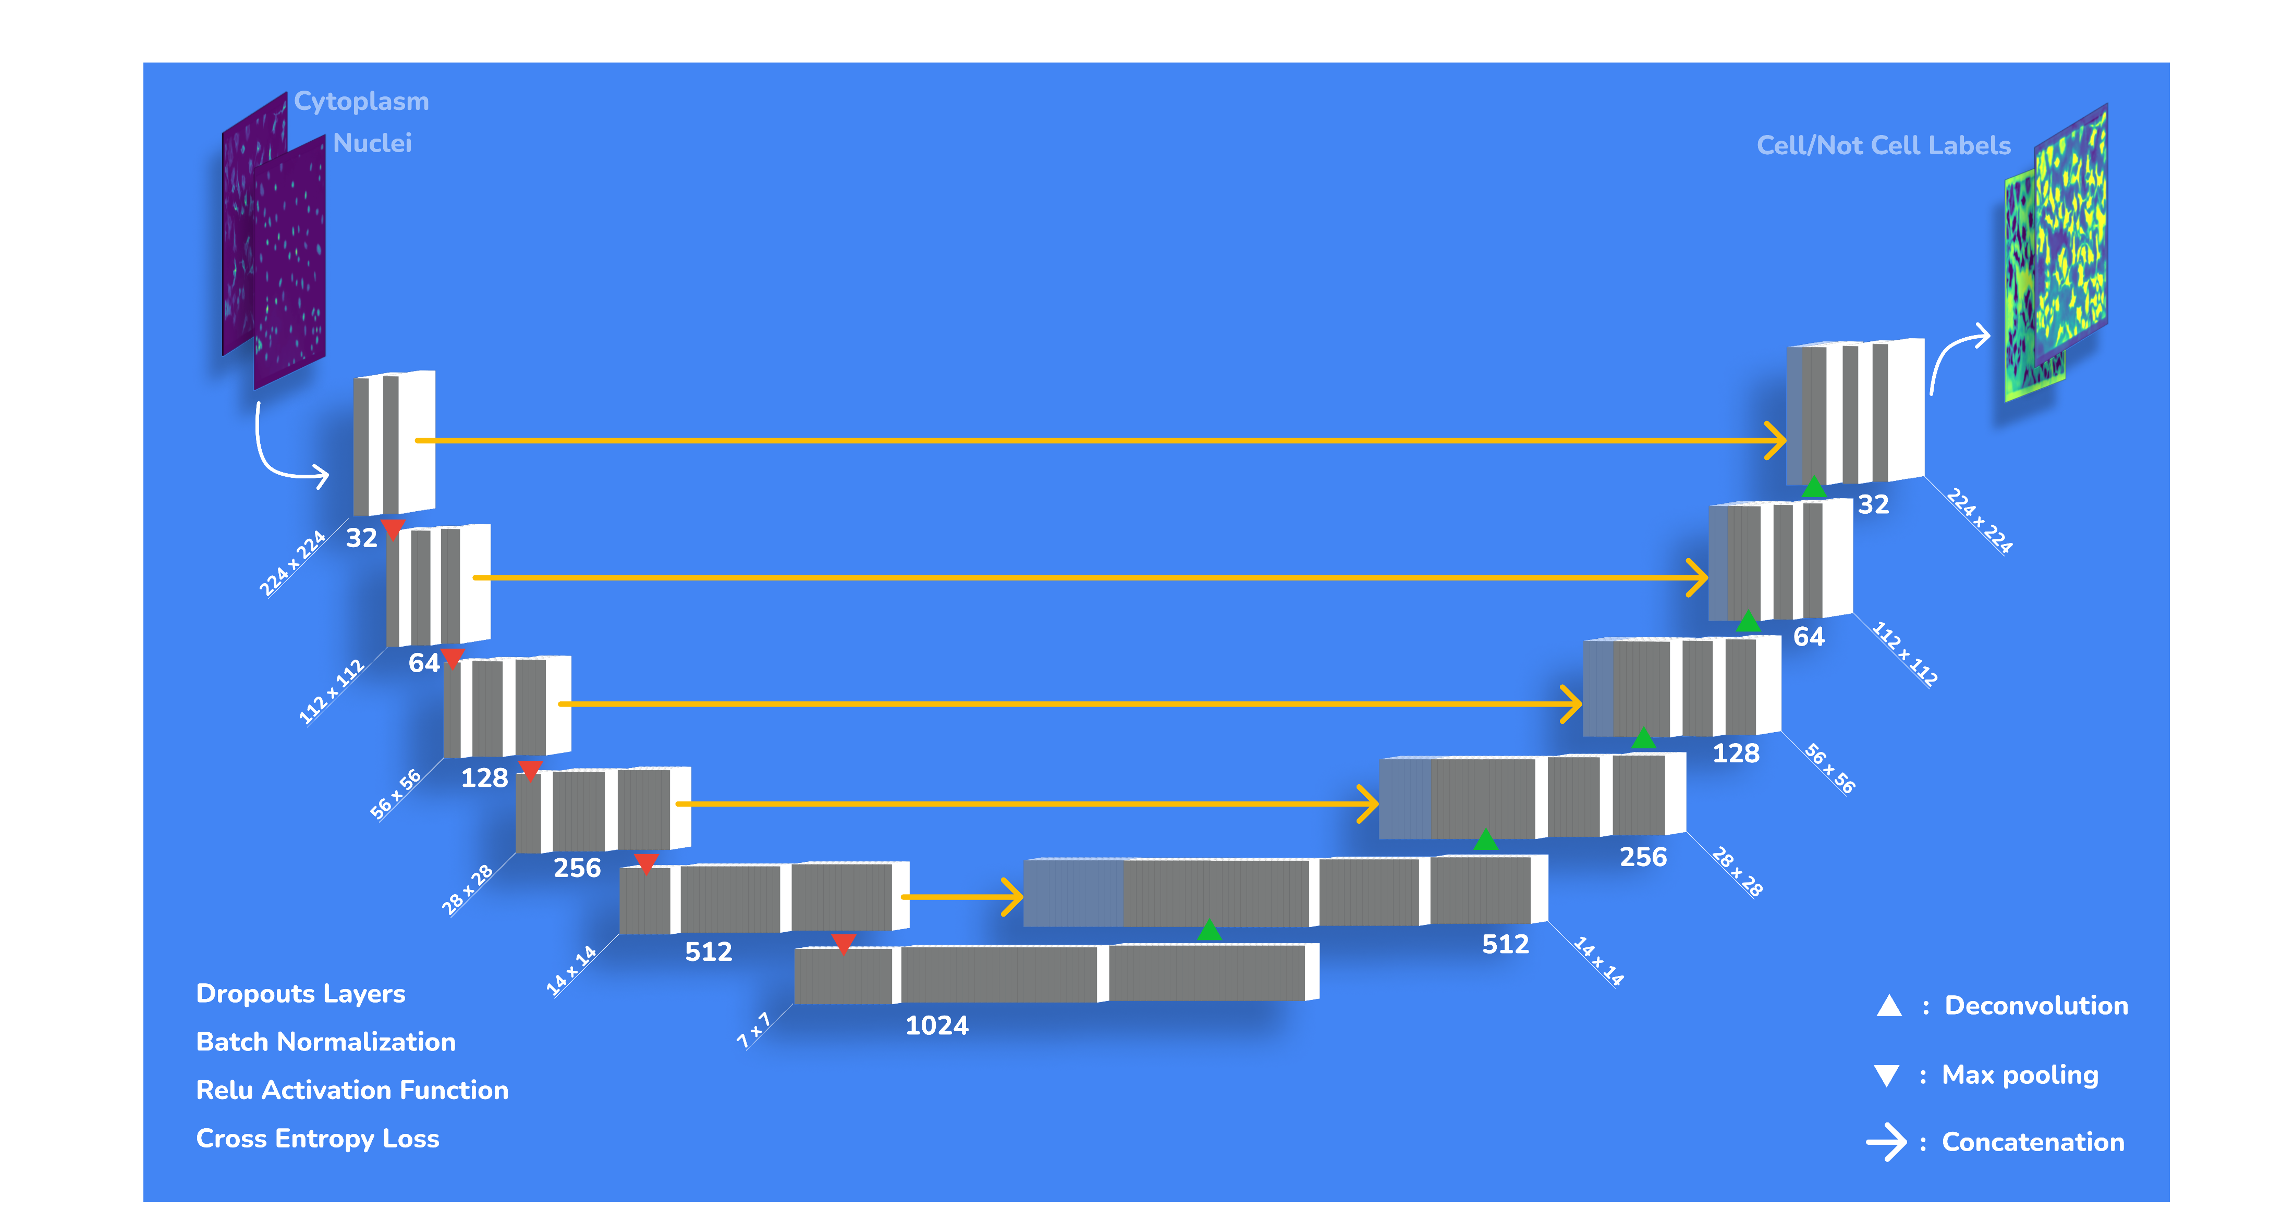

Slide 7
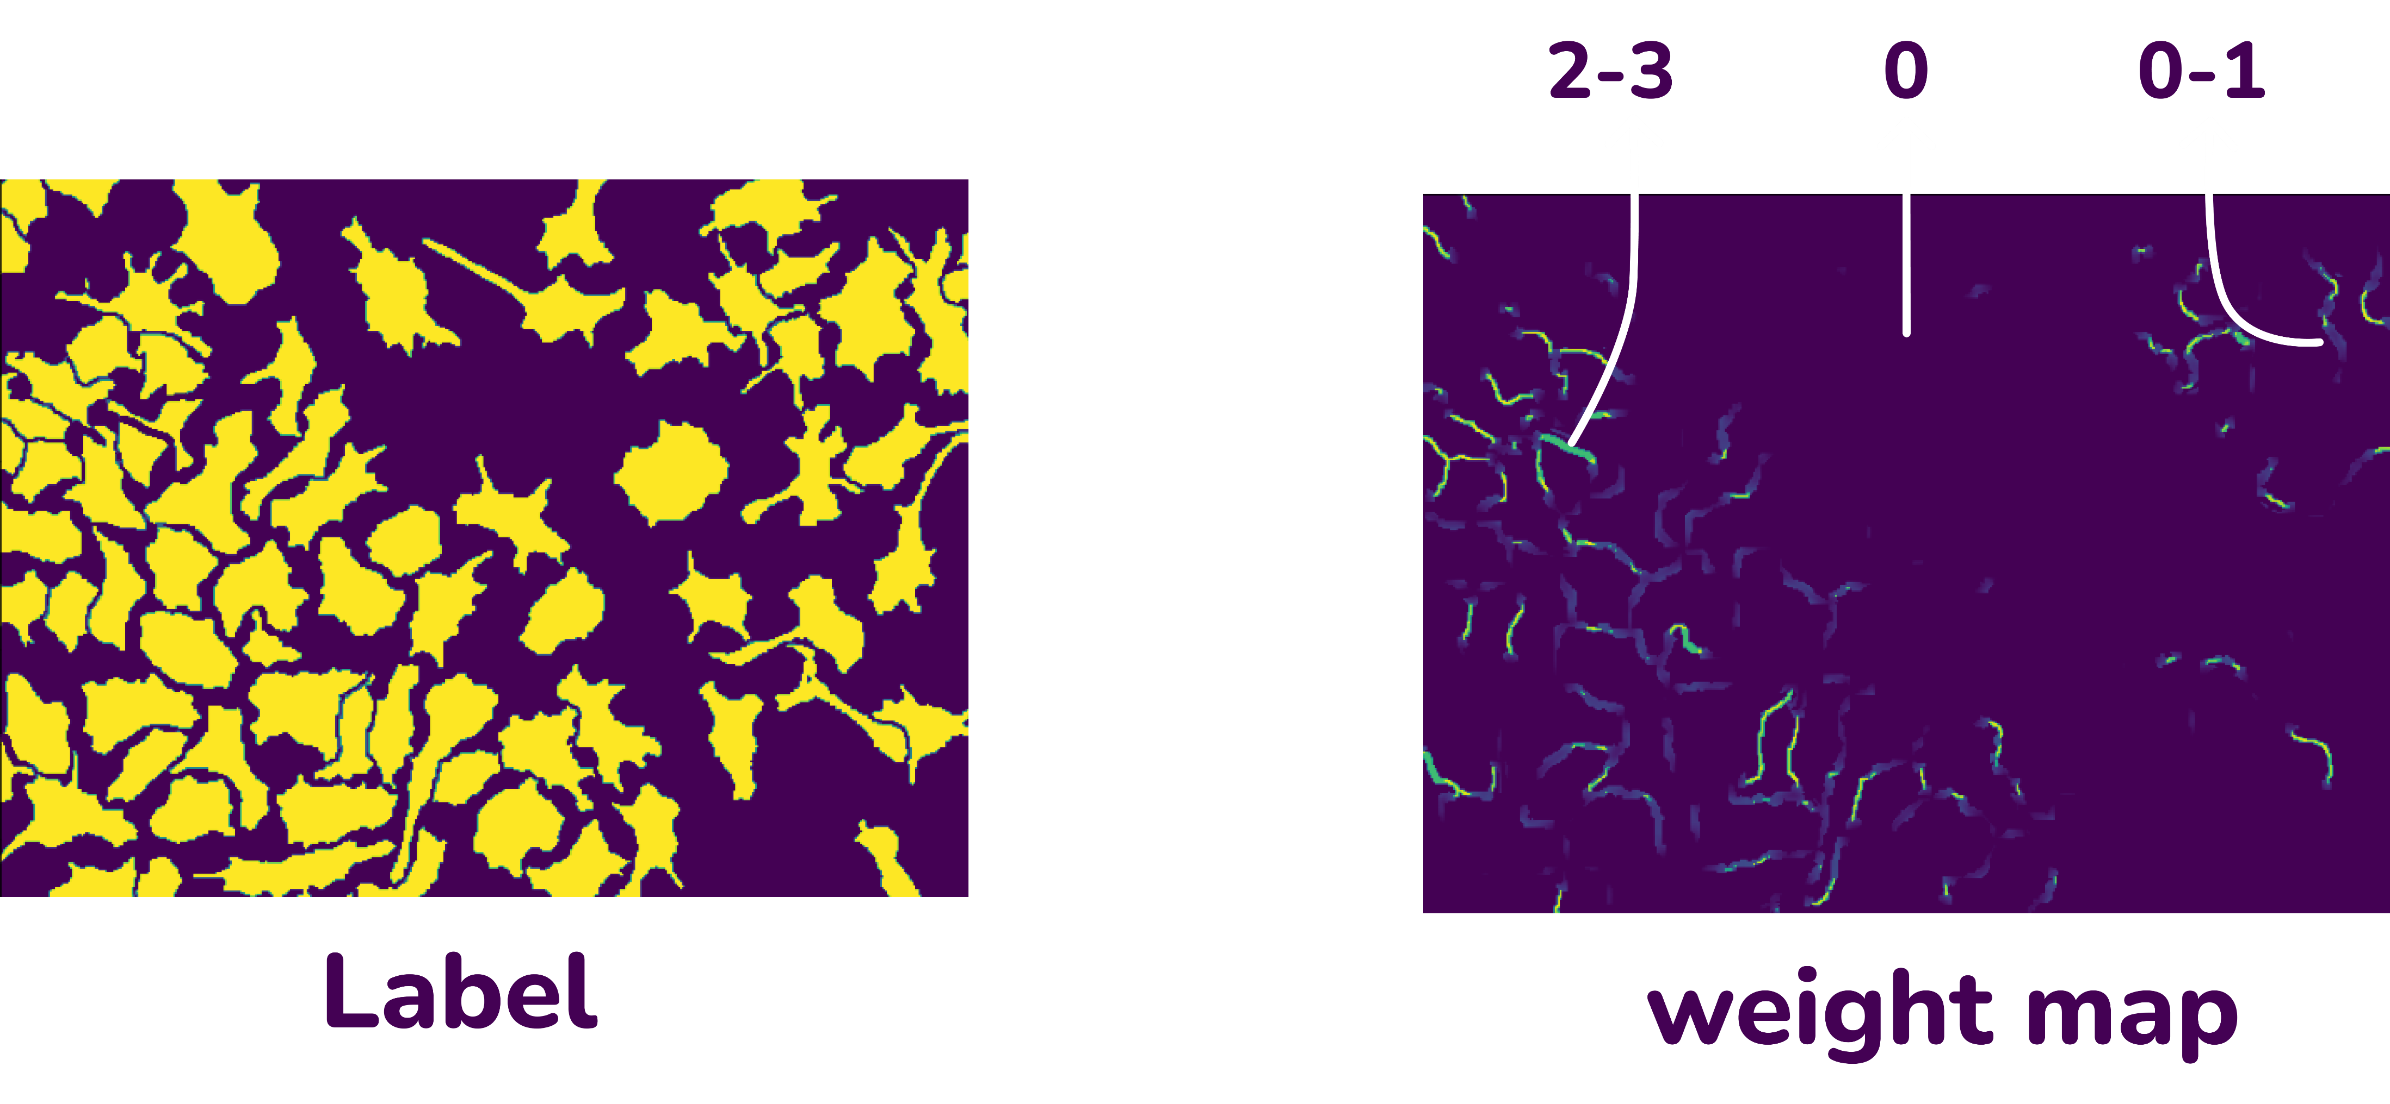
You cant escape from
Weight map

Slide 8
w
Loss = ((Weight_map * )+1)*loss

Slide 9
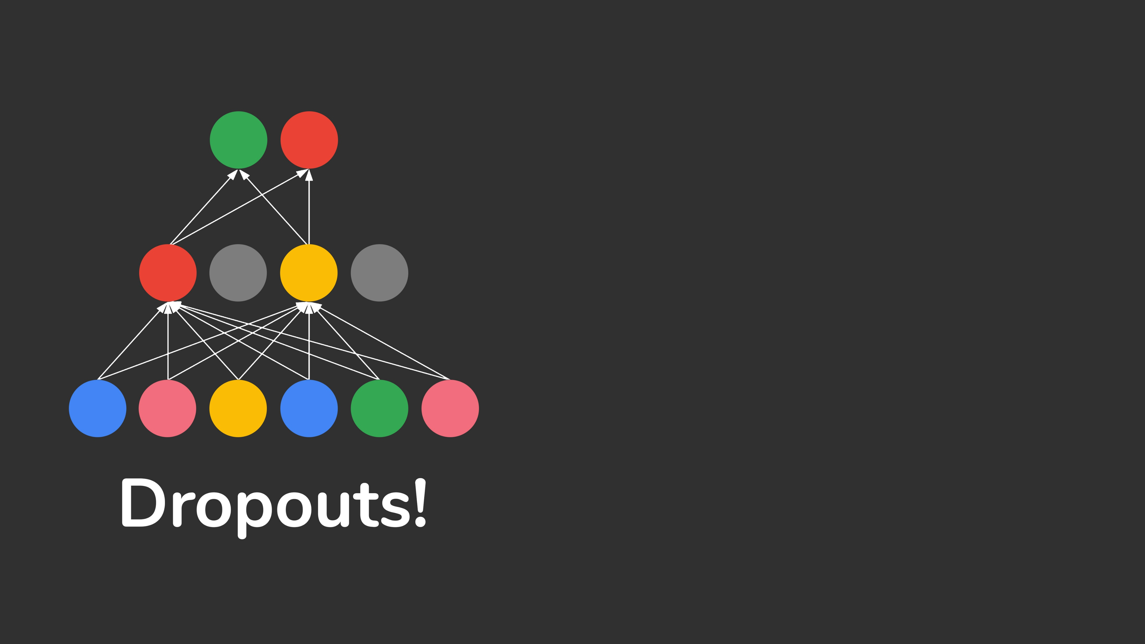
class downsample(nn.Module):
def __init__(self, nbase, kernel_size):
super().__init__()
self.down = nn.Sequential()
self.maxpool = nn.MaxPool2d(2, 2)
for n in range(len(nbase) - 1):
self.down.add_module('conv_down_%d'%n,
convdown(nbase[n],
nbase[n + 1],
kernel_size, n*0.15))
Drop out
probability
It increases as we dig
deep into the network.

Slide 10
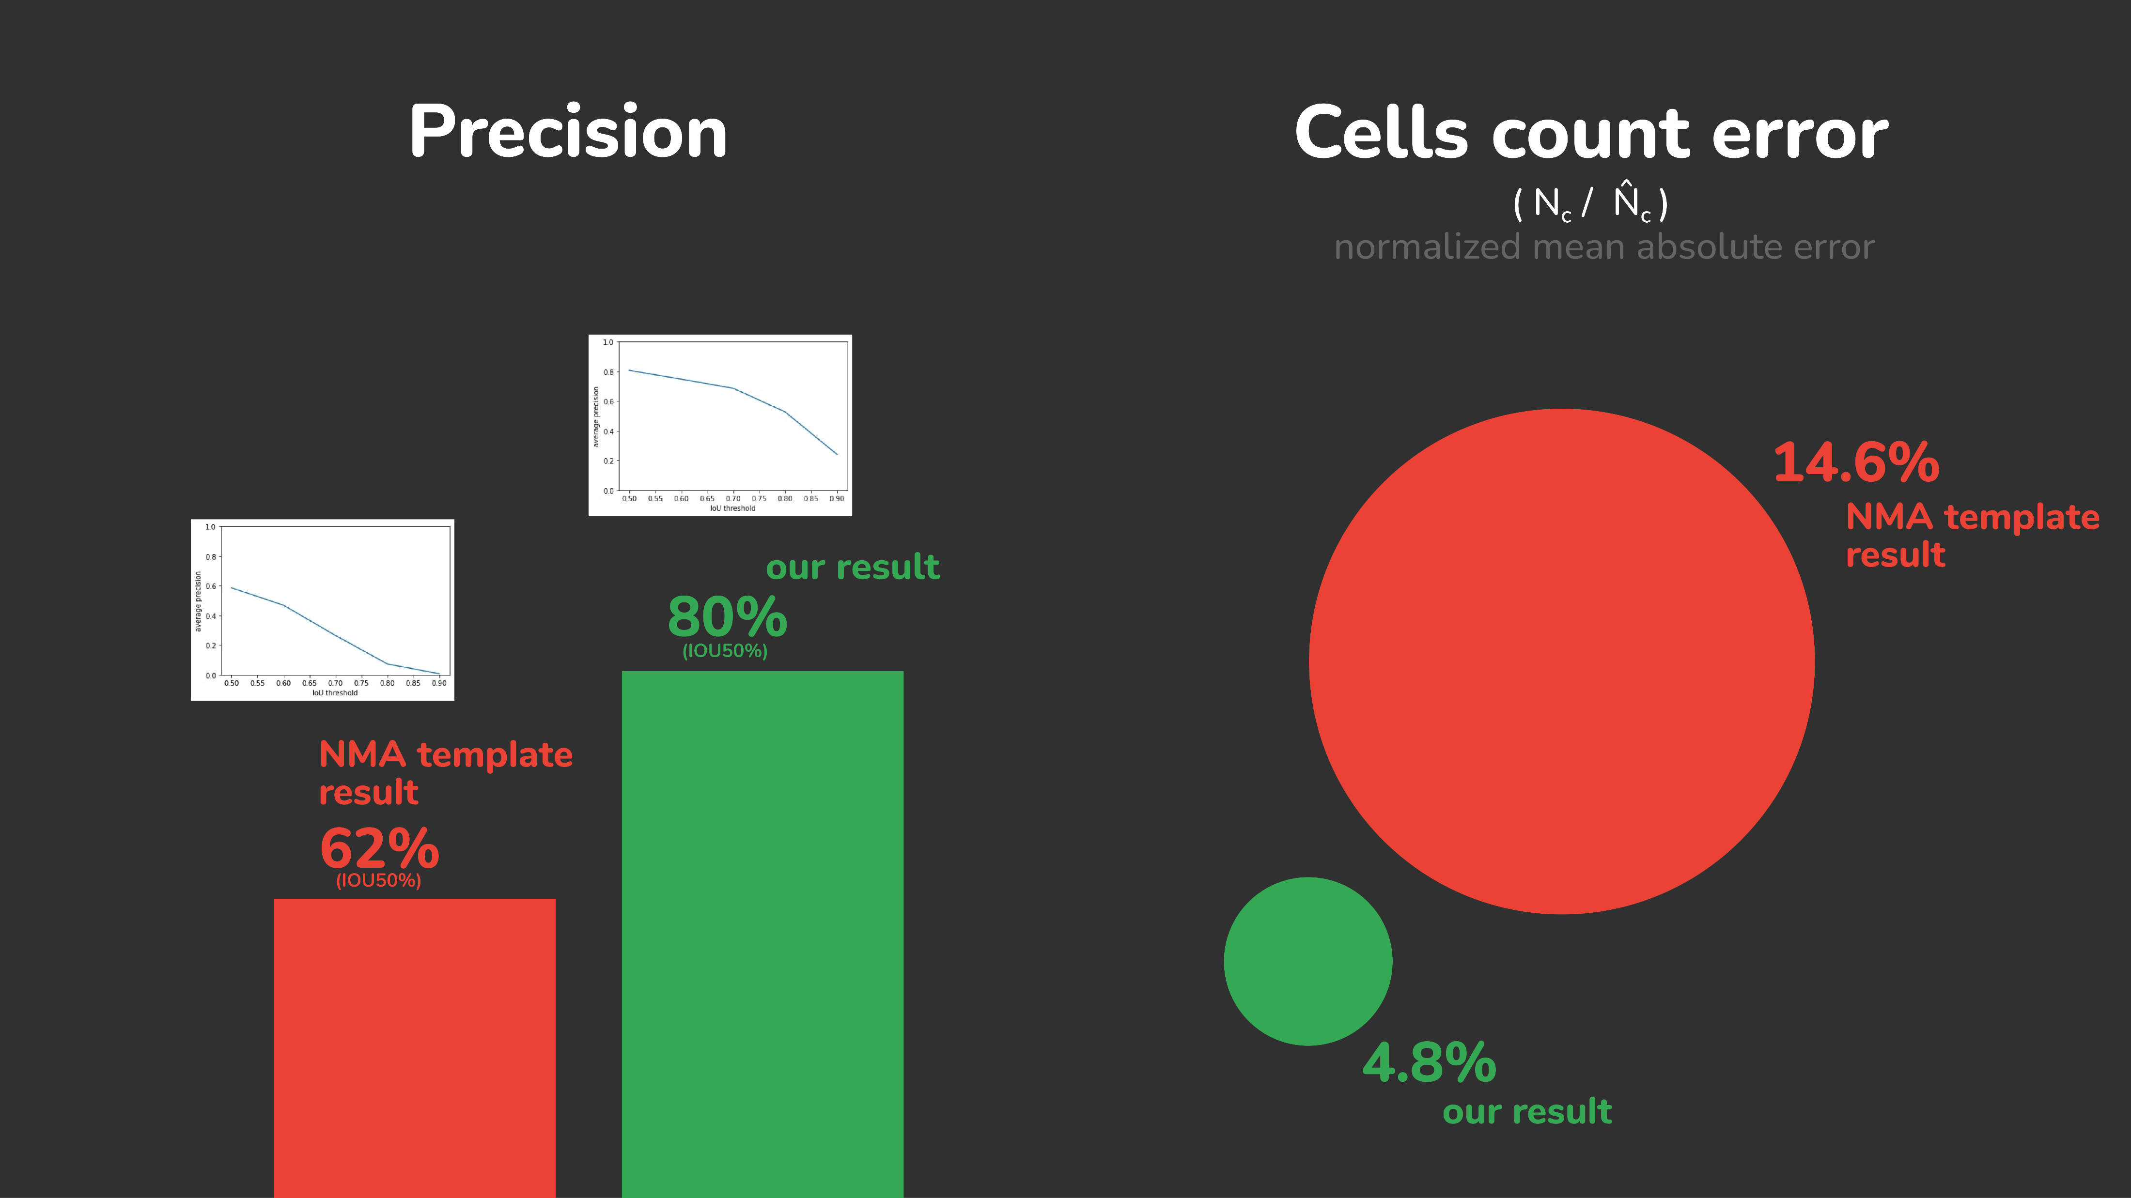
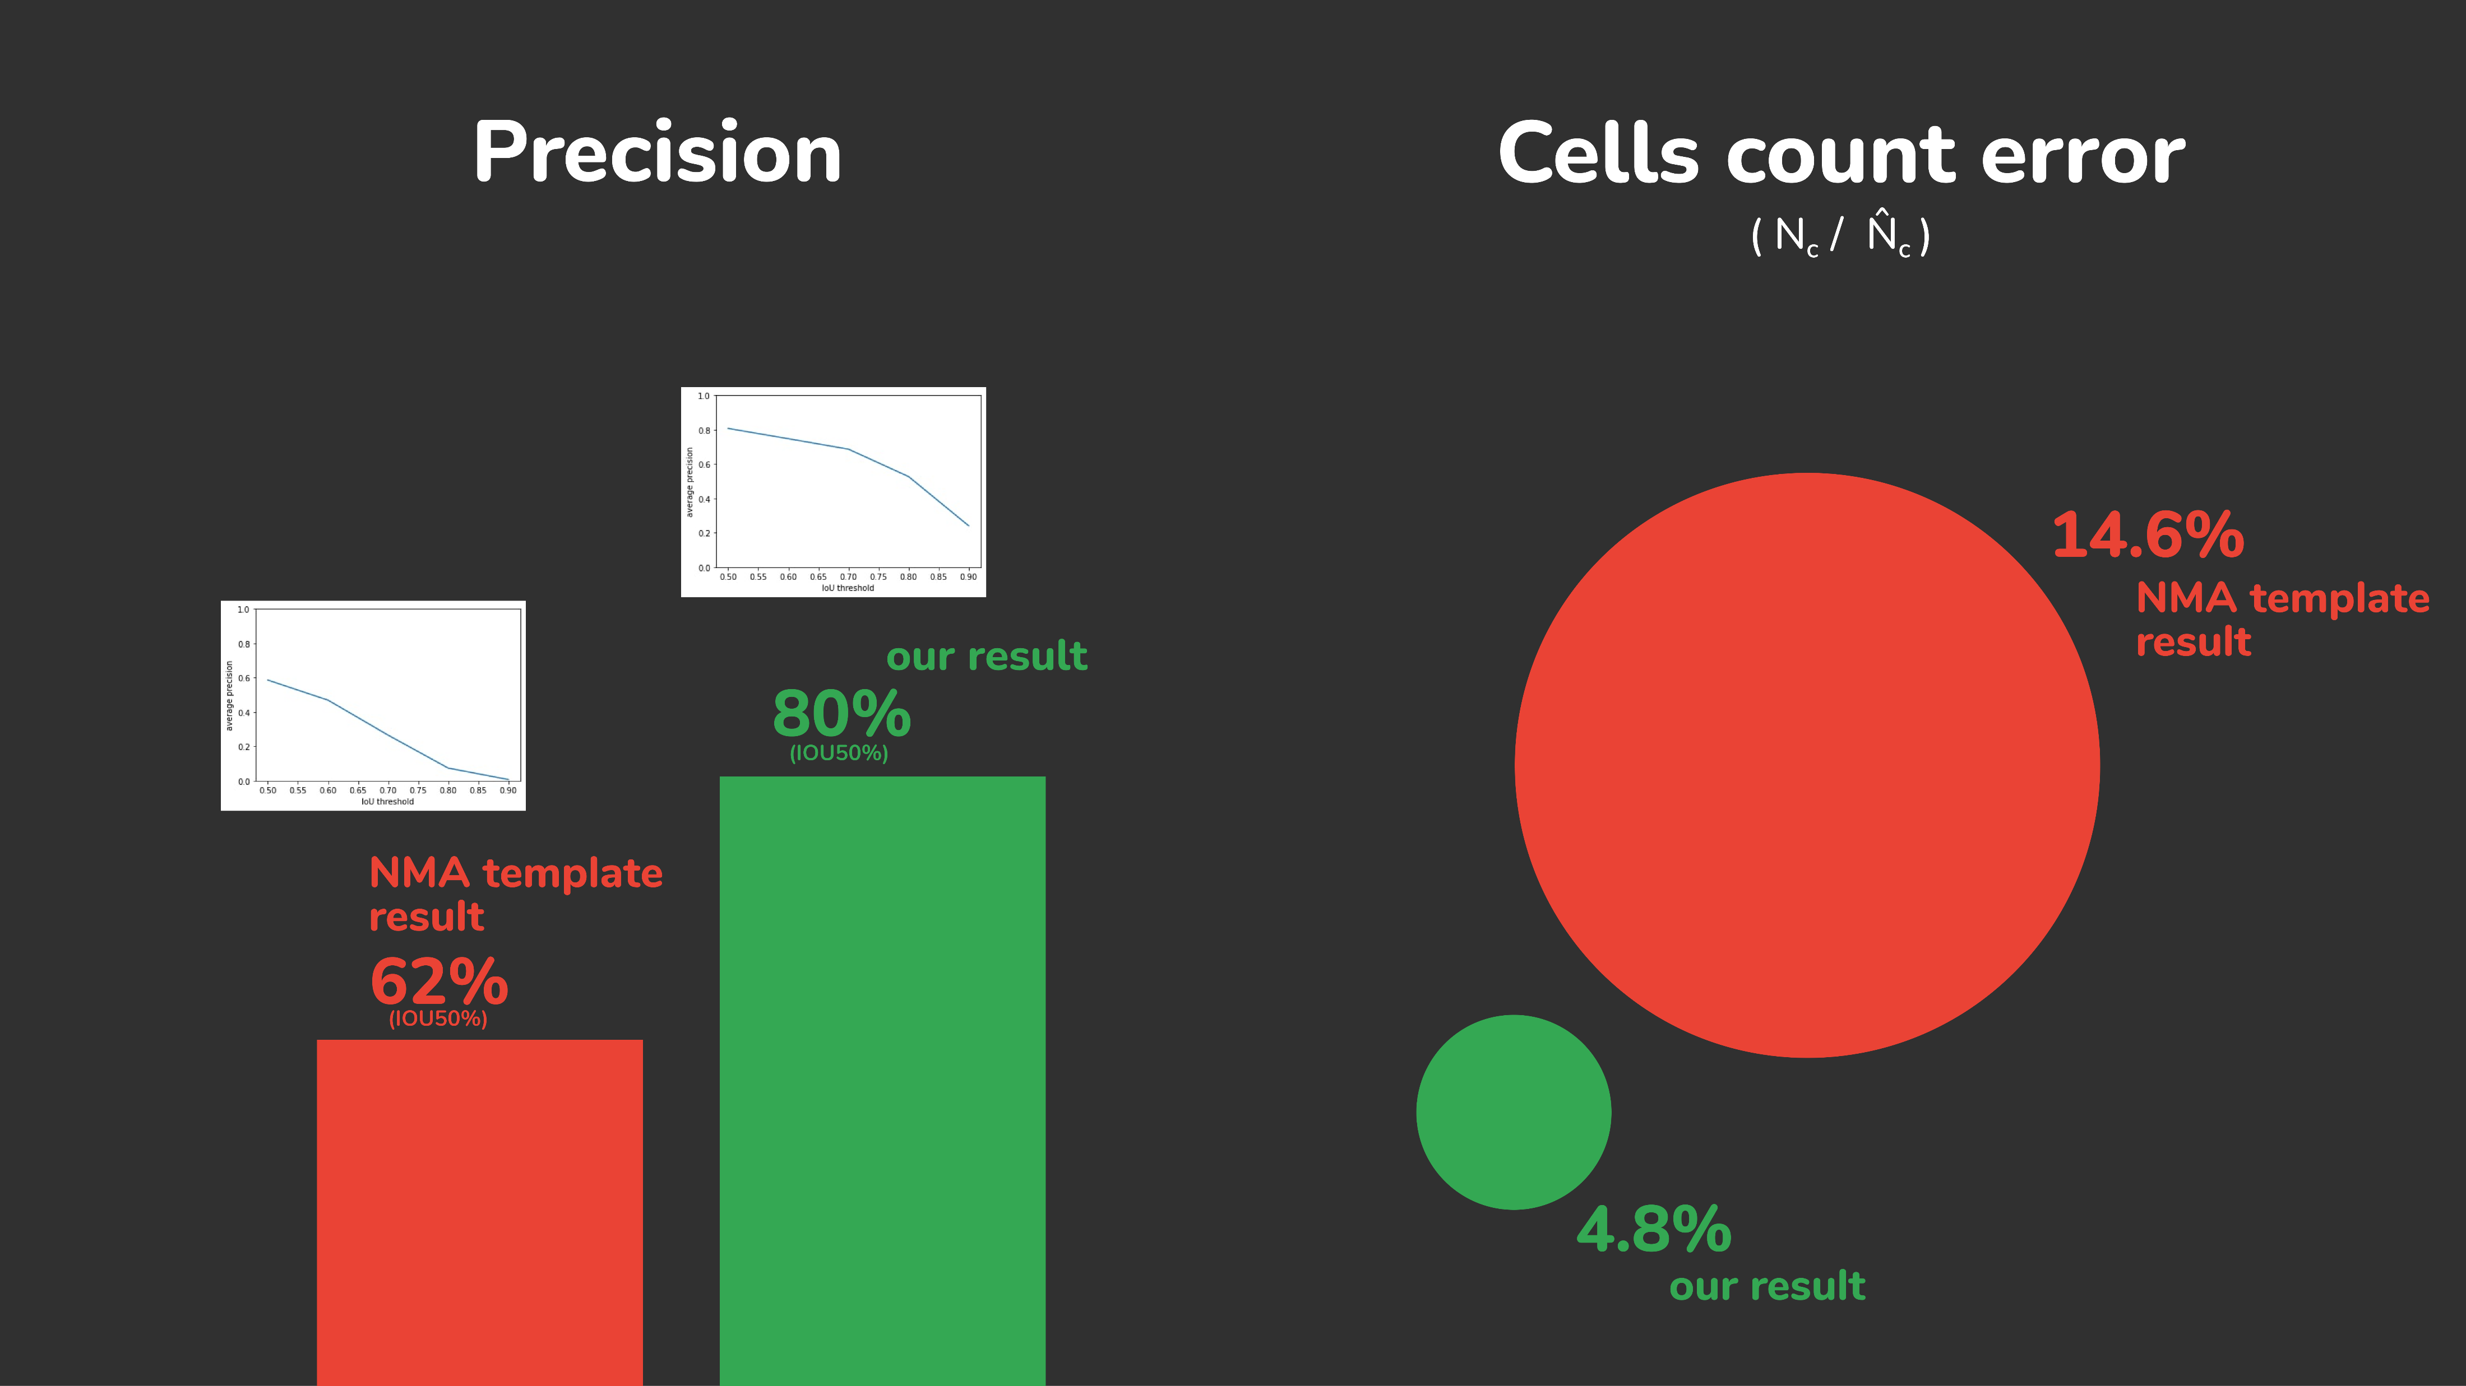
precision
IOU
precision
IOU

Slide 11
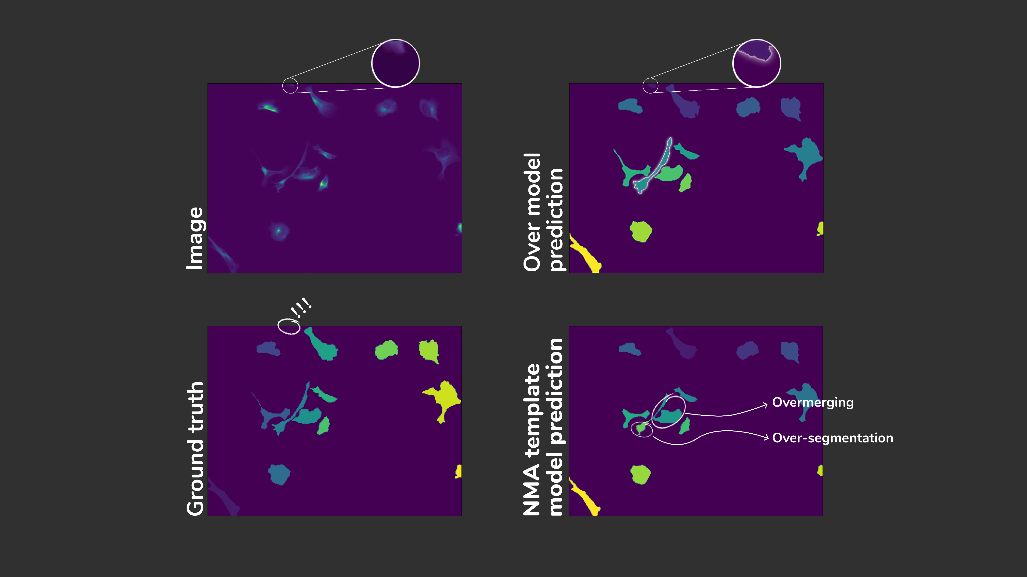
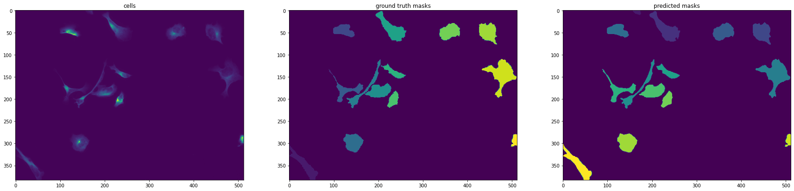
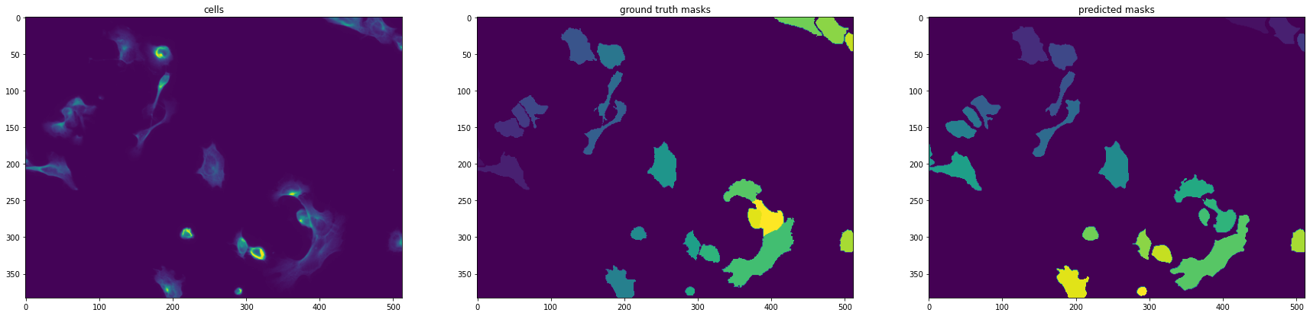
Image
predicted
Ground truth

Slide 12
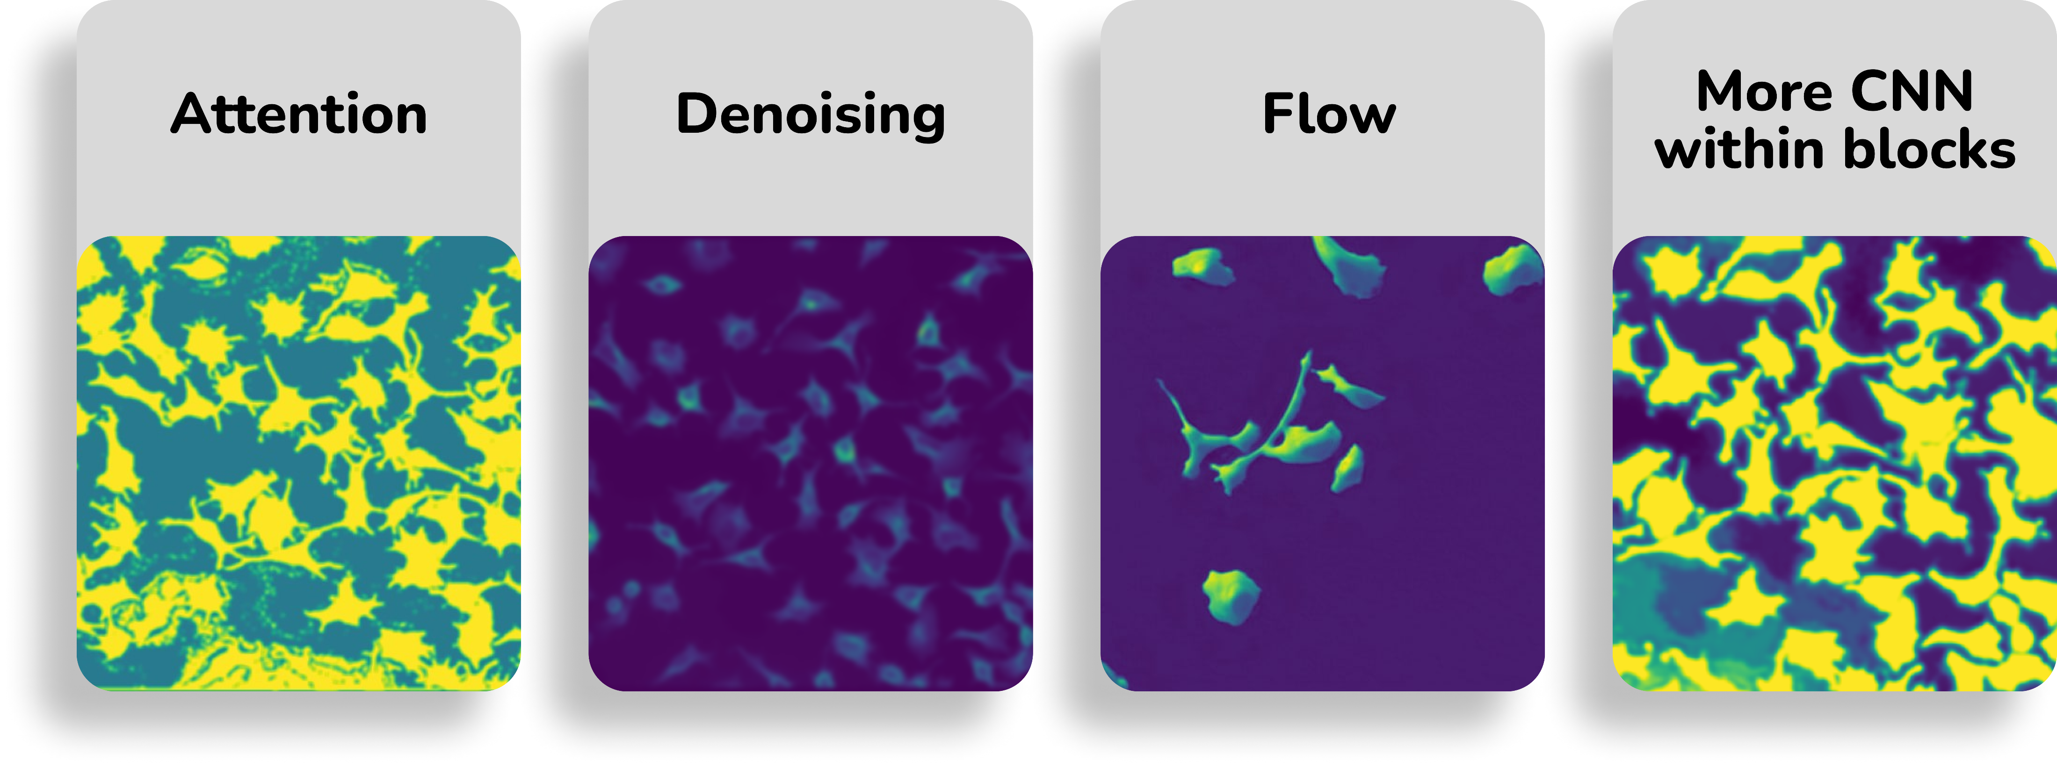
We learn from
Failures

Slide 13
Future
works
Attention
and
flow
RGB
Seq.
data
Transfer
learning

Slide 14
Thank You
Any
Questions?

